Slide 1
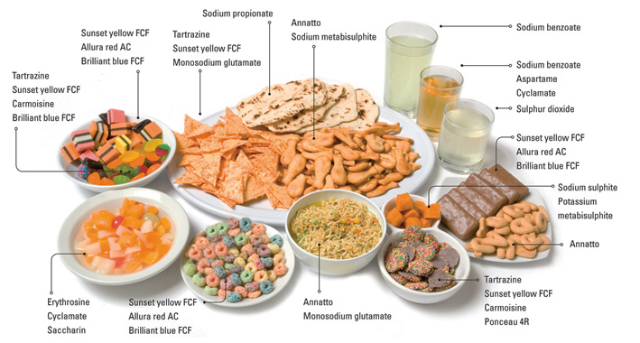
Chapter 24 Food Additives
By: Lexi Carp, Devon Grissinger, and Nina Salvucci

Slide 2
Objectives and Vocabulary
Objectives:
Identify common food additives and their uses
Compare natural and synthetic additives
Explain how additives are regulated
Identify general and specific uses of preservatives
Compare methods for adding nutrients to foods
Describe how additives make food more appealing
Describe how additives aid food processing
Evaluate the pros and cons of using food additives
Vocab:
-Food Additives
-GRAS List
-Enrichment
-Fortification
-Restoration
-Nitrification
-Goiter
-Stabilizer

Slide 3
What is a Food Additive?
Any substance a food producer intentionally adds to a food for a specific purpose
Around 3,000 additives used to preserve foods
Natural and Synthetic additives
Natural
Additives such as salt and sugars have been around thousands of years
Occur naturally in food or plants
Synthetic
Artificial or synthetic additives are made in a laboratory
Not found naturally in food

Slide 4
Regulating Additives
(FDA)The Food and Drug Administration is responsible for keeping food safe for consumers
FDA holds manufacturers accountable for labeling additives in food products
There are four purposes of additives
Improve storage properties
Increase healthfulness
Make food more appealing
Improve processing and preparing

Slide 5
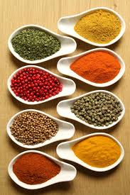
GRAS List
contains substances, like spices, natural seasonings, and flavorings, that are considered safe for human consumption (not regulated as additives)

Slide 6
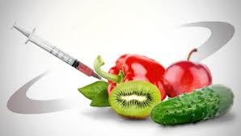
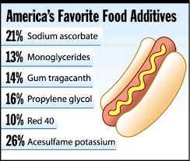
How Additives are Used
Improving Storage Properties –
Preservatives-chemicals used to prevent mold and bacteria from spoiling food
Don’t affect a food’s flavor, color , or texture
Preservatives can have an added purpose
To color and flavor cured meats

Slide 7
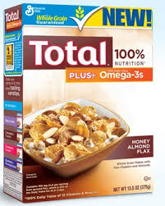
Increasing Healthfulness
Fortification – adding nutrients not normally found in the food
Restoration – nutrients that are lost in processing are returned to the food
Enrichment – adding nutrients lost in processing back in the food along with extra nutrients that did not exist before

Slide 8
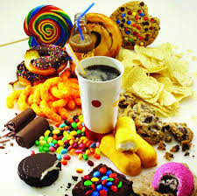
Making Food More Appealing
Color: Synthetic coloring is safe/FDA approved. Natural coloring may come from caramelization
Flavor: Most flavoring is artificial and flavor enhancers are made from the amino acid glutamate
Sweeteners: Sucralose, saccharin, aspartame, and acesulfame
Nonnutritive sugars- artificial sweeteners and have no calories.
Nutritive sweeteners- natural and metabolize to produce calories.
Food Additives (3:47)
http://www.abc.net.au/btn/story/s3340159.htm

Slide 9
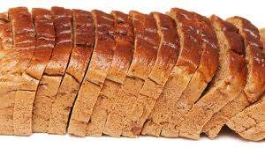
Improving, Processing and Preparation
Stabilizers and thickeners are usually natural additives and they contribute to the body of the food
Stabilizer- A substance that keeps a compound, mixture, or solution from changing its form or chemical nature

Slide 10
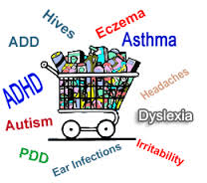
Concerns About Food Additives
Long-term effects: Scientists found that nitrates can cause cancer over time and under extreme heat
Food Allergies/Sensitivities: Reactions to MSG, sulfites, and BHT are rare but can be severe; they are also difficult to avoid

Slide 11
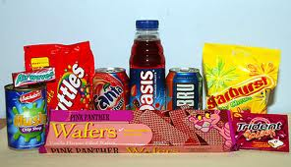
Food Additives
Pros:
Food is more appealing to the eye and tasty
Cons:
Long term effects such as cancer
Food allergies to additives are hard to avoid and can be severe

Slide 12
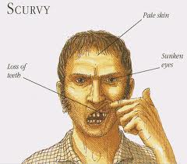
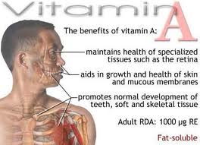
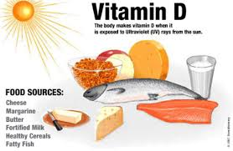
Poor Eating Habits
Leads to nutrient deficiencies
Adding nutrients where they don’t occur naturally makes getting balanced nutrition more confusing

Slide 13
Unneeded Additives
Wax on apples, oranges, eggplant and lemons are FDA-approved as preservative
-maintain freshness by sealing in moisture
Critics warn that by conditioning buyers to set unnatural standards for foods, producers discourage people from eating what’s really good for them
Using additives raises the price of the product

Slide 14
The Value of Food Additives
Safety
Proponents stress that producers and consumers alike now rely on additives to help ensure a safe food supply
Preservatives extend the shelf life of some products
-A loaf of bread stays edible because of the mold inhibitor calcium propionate and the BHT that keeps fats from going rancid, additive ethylenediamine tetraacetic acid helps prevent rancidity
Improves Nutrition
Supporters say additives prevent diseases caused by malnutrition
First case of fortification in the United States was prompted by high rates of goiter, an enlargement of the thyroid gland caused by lack of iodine.
Vitamin D to milk in the 1930s
Fortifying flour and cornmeal with iron and niacin
Preservatives

Slide 15
World Hunger
With additives, foods can be shipped safely over long distances
Supporters suggest that some fears about using additives are a reaction against using chemicals
Chemical additives are no more dangerous than the food itself

